Slide 1
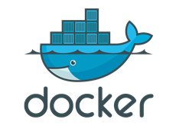
Docker Networking

Slide 2
CNM
CNM is an open-source networking specification for containers.
CNM defines networks, endpoints, sandboxes.
Libnetwork is Docker’s implementation of CNM.
Libnetwork is extensible via pluggable drivers which allows various network technologies.
Notes:
https://thenewstack.io/container-networking-landscape-cni-coreos-cnm-docker/

Slide 3
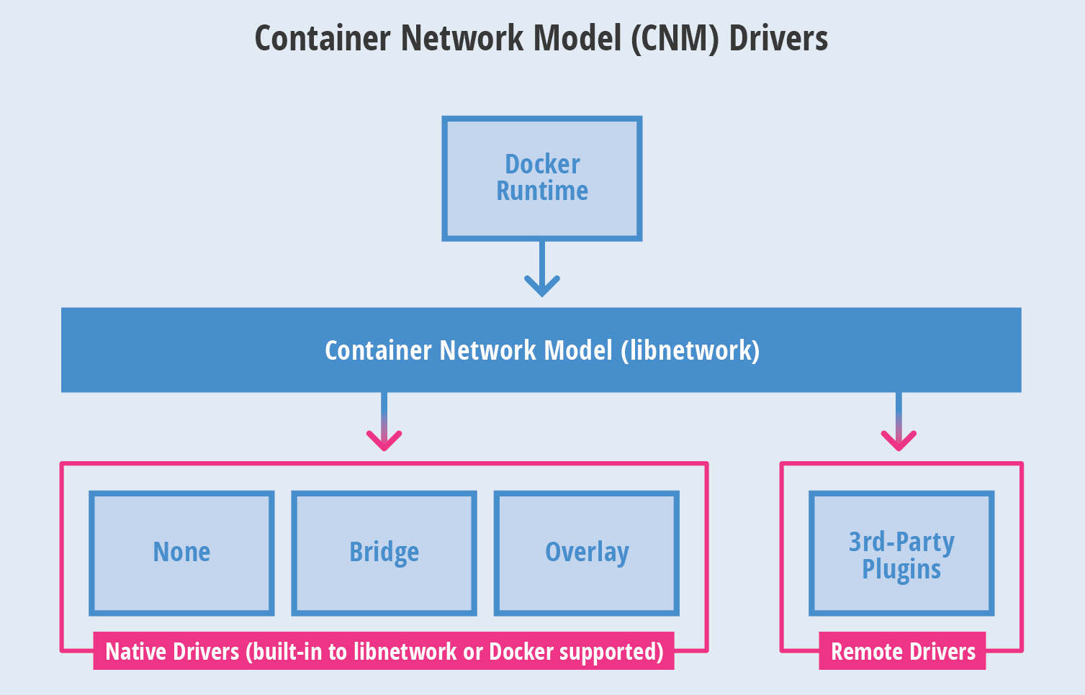
CNM Architecture
Notes:
https://thenewstack.io/container-networking-landscape-cni-coreos-cnm-docker/

Slide 4
Containers and CNM
Container
End Point
Network
Sandbox
Network A
Network B
Notes:
https://www.youtube.com/watch?v=2vcLgcH_hDI

Slide 5
Native Docker Drivers
$ docker info
<snip>
…
Plugins:
Volume: local
Network: bridge host macvlan null overlay
…
<snip>
Docker’s networking subsystem is pluggable, using drivers.
Kernel networking features like Linux bridge, iptables, VXLAN, net namespaces etc. are used.
Native includes bridge, overlay, host, macvlan, null.

Slide 6
Listing Network Drivers
NETWORK ID NAME DRIVER SCOPE
440c94c79422 bridge bridge local
d5198b0f55c4 host host local
342a5cd17896 none null local
$ docker network inspect 440c94c79422
"Name": "bridge",
<snip>
"Config": [
{
"Subnet": "172.17.0.0/16"
}
]
<snip>

Slide 7
Bridge Driver
Default driver when a container is run
User defined bridge networks can be created
Bridge networks apply to containers running on the same host.
Has its own IP address allocation mechanism
Very robust
Docker Host
Container 1
Container 2
Container 3
eth0
eth0
eth0
Bridge
eth0

Slide 8
Bridge Driver
Docker Host
Docker Host
Container 1
Container 2
Container 3
Container 4
Container 5
eth0
eth0
eth0
eth0
eth0
172.17.0.2
172.17.0.3
172.17.0.4
172.17.0.3
172.17.0.5
Bridge
172.17.0.1
Bridge
172.17.0.1
eth0
eth0
192.168.1.100
192.168.1.101
External Network
Within a Docker host, all containers connected to same bridge can communicate
Container to external network done via PAT (iptables)

Slide 9
Bridge Networking and Port Mapping
Docker Host
Access to containers via port mapping
Map container port to host port
docker run –p 8080:80 ….
Container
eth0
172.17.0.3: 80
Bridge
172.17.0.1
eth0
192.168.1.101: 8080
Host port
Container port

Slide 10
Multi Host Networking – Overlay Driver
Docker Host
Docker Host
Container 1
Container 2
Container 3
Container 4
Container 5
eth0
eth0
eth0
eth0
eth0
172.17.0.1
172.17.0.2
172.17.0.3
172.17.0.4
172.17.0.5
Overlay Network
All containers connected to the overlay network can communicate
Helps in overcoming the port mapping complexity associated with bridge networking

Slide 11
Overlay Driver – VXLAN
Docker Host
Docker Host
VTEP
VTEP
eth0
eth0
Underlay Network
VXLAN tunnel is created through the underlay network
VTEPs perform encapsulation and de-encapsulation of VXLAN packets

Slide 12
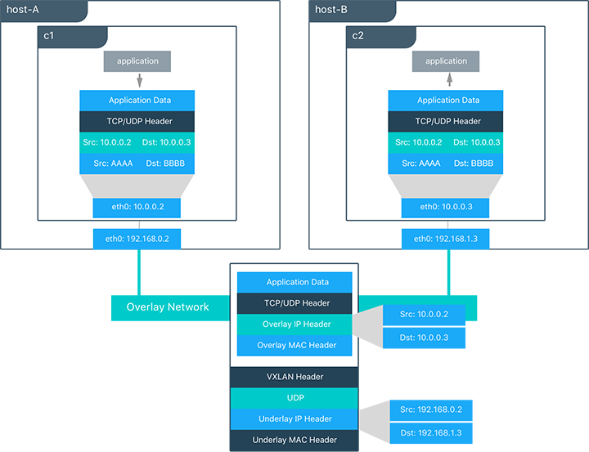
Overlay Driver – Data Plane
Notes:
https://en.wikipedia.org/wiki/Gossip_protocol
https://docs.docker.com/network/overlay/#bypass-the-routing-mesh-for-a-swarm-service

Slide 13
Overlay Driver – Control Plane
Docker Host
Docker Host
gossip
libnetwork
libnetwork
eth0
eth0
Underlay Network
Uses gossip protocol. Fast convergence
Data plane and Control plane traffic can use different interfaces using the “--advertise-addr” flag
Notes:
https://docs.docker.com/network/overlay/#operations-for-swarm-services

Slide 14
Overlay Driver – Port Publishing
Docker Host
Docker Host
Container 1
Container 2
Container 3
Container 4
Container 5
eth0
eth0
eth0
eth0
eth0
172.17.0.1
172.17.0.2
172.17.0.3
172.17.0.4
172.17.0.5
eth0
192.168.1.100
eth0
192.168.1.101
Overlay Network
“docker service create –name web –publish 8080:80 –replicas 2 nginx”
Port 8080 exposed on every host in the cluster

Slide 15
MACVLAN Driver
Docker Host
Docker Host
Container 1
Container 2
Container 3
Container 4
Container 5
eth0
eth0
eth0
eth0
eth0
172.17.0.2
172.17.0.3
172.17.0.4
172.17.0.5
172.17.0.6
eth0
eth0
172.17.0.1
172.17.0.254
Physical Network
Use of sub-interfaces (dot1q)
Container gets its own IP /MAC visible on the physical network

Slide 16
Disable Networking for Container
$ docker run --network none --name no-net-alpine centos
$ docker exec no-net-alpine ip link show
1: lo: <LOOPBACK,UP,LOWER_UP> mtu 65536 qdisc noqueue state UNKNOWN qlen 1
link/loopback 00:00:00:00:00:00 brd 00:00:00:00:00:00
2: tunl0@NONE: <NOARP> mtu 1480 qdisc noop state DOWN qlen 1
link/ipip 0.0.0.0 brd 0.0.0.0
3: ip6tnl0@NONE: <NOARP> mtu 1452 qdisc noop state DOWN qlen 1
link/tunnel6 00:00:00:00:00:00:00:00:00:00:00:00:00:00:00:00 brd 00:00:00:00:00:00:00:00:00:00:00:00:00:00:00:00
Use the --network none flag when starting the container to disable networking
Within the container, only the loopback device is created

Slide 17
Networking Drivers Summary
Bridge networks are best when you need multiple containers to communicate on the same Docker host.
Overlay networks are best when you need containers running on different Docker hosts to communicate, or when multiple applications work together using swarm services.
Macvlan networks are best when you are migrating from a VM setup or need your containers to look like physical hosts on your network, each with a unique MAC address.
Third-party network plugins allow you to integrate Docker with specialized network stacks.
Notes:
To use third party drivers:
https://docs.docker.com/engine/extend/plugins_network/#network-driver-plugins-and-swarm-mode

Slide 18
Useful Commands
docker network ls
docker network inspect
docker network create
Notes:
To use third party drivers:
https://docs.docker.com/engine/extend/plugins_network/#network-driver-plugins-and-swarm-mode

